Slide 1
EASYWORK:Service Provide Web Application
.

Slide 2









EASYWORK: SIMPLIFYING SERVICES WITH ADVANCED TECHNOLOGY
ROLL NO: 2003420100064
ROLL NO:2003420100059
ROLL NO:2003420100055
ROLL NO: 2003420100059

Slide 3
PROBLEM STATEMENT
OBJECTIVE
PROBLEM SOLUTION
TECHNOLOGY USED
SERVICES

Slide 4

Problem Statement
Users can have problem getting in touch with many local services due to changing circumstances
Users can access bad services
3.Insufficient access
Customers will have problems accessing many local services

Slide 5
Objective

Slide 6








Problem solution
•
: EasyWork offers a user-friendly interface for hassle-free service booking, eliminating inefficiencies in the current process.
:By providing AI-powered personalized recommendations and detailed service provider prof iles, EasyWork empowers users to make informed choices.
: EasyWork's ML-based face recognition ensures secure and convenient authentication, enhancing user experience and data security.Easy
•
•

Slide 7
Tools used
Frontend-HTML,CSS, TypeScript
Backend-MySQL, GoLang
Secure Payment Gateway
Framework: Angular

Slide 8
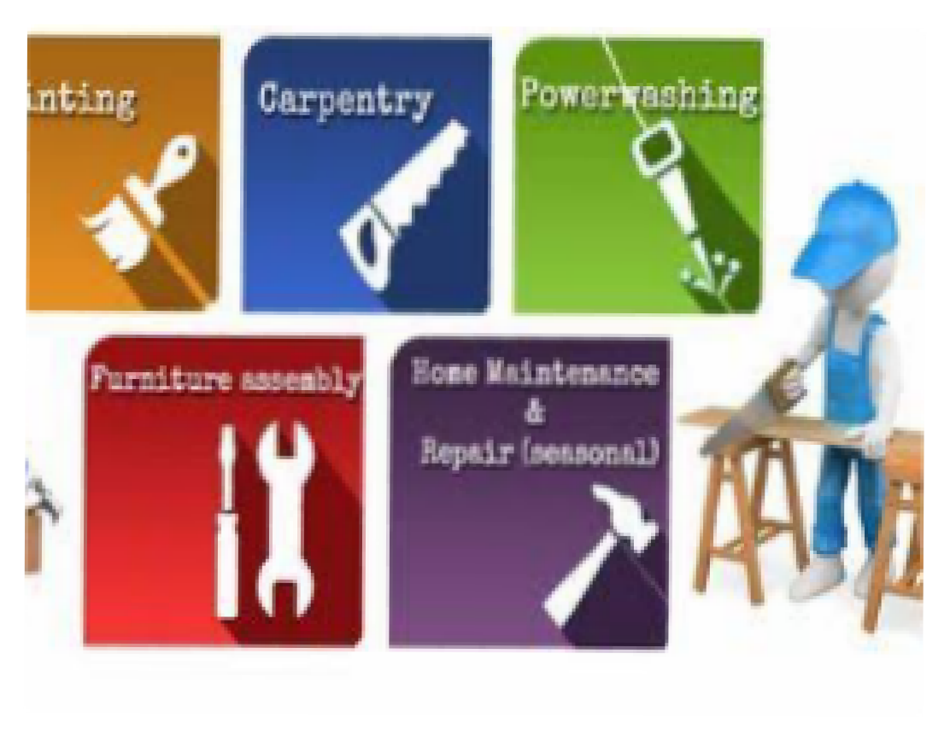

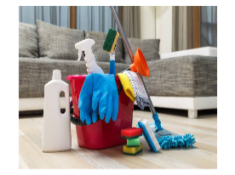
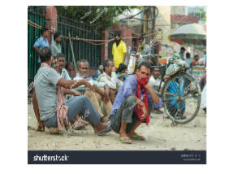



Slide 9














Services
: Plumbing, electrical repairs, carpentry, painting, and general maintenance for residential properties.
Professional cleaning for homes, offices, apartments, specialized cleaning (e.g., carpets, windows), and post-construction cleaning.
For workers based on skills and industry standards, promoting financial security and recognition.

